Slide 1

Distinguish between rocks and mines using Sonar Signal Prediction
10512387 – DEEPAKVANSHIKUMAR TUNIYA
10514141 – JAYESH DEOGIRIKAR

Slide 2
INTRODUCTION
In this project we will predict the best accurate model to discriminate sonar signals which bounce off by roughly rock cylinders and by metal cylinder mines.
We perform CRISP-DM methodology on our model which stands for CRoss Industry Standard Project for Data Mining.
It is powerful and robust model.
It defines life cycle of Data mining Project.

Slide 3
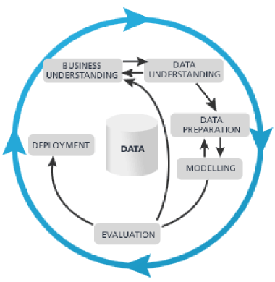
OVERVIEW
6 STAGES IN CRISP DM MODEL PROCESSING:
Business Understanding
Data Understanding
Data Preparation
Modelling
Evaluation
Deployment

Slide 4
Business Understanding
Navy uses sonar signal to check if there are any obstacles blocking their path.
In this phase we need to distinguish between the rock structures and metals structures such as seas mines on the sea floor.
The sonar signals are tested on the sandy ocean floor for the Cold War.
It is very important to discriminate between rocks and mines as it is necessary to know that the sonar signal is received from which geological material on the sea floor.

Slide 5
Resources Available
DATA SET – Sonar Signals
DATA MININg TOOL – Rapidminer Studio
Programming tool – R studio

Slide 6
Data Understanding
This is stage two of the CRISP- DM model.
Data understanding phase consist of 3 steps.
Collect the data
Describe the data
Explore the data

Slide 7

Collect The Data
The dataset implemented is a sample data set from RapidMiner Studio and is available on Kaggle too.
https://www.kaggle.com/adx891/sonar-data-set

Slide 8
Describe the Data
The format of the data is CSV.
It is a sample dataset with 208 (examples) rows and 61 (attributes) columns .
It is Multivariate dataset.
It has 60 columns with each column having set of ranges from 0.0 to 1.0. The range represents energy with particular frequency band, integrated over certain period of time.

Slide 9
Describe the Data
The label associated with each record contains the letter "R" if the object is a rock.
"M" if it is a mine (metal cylinder).

Slide 10

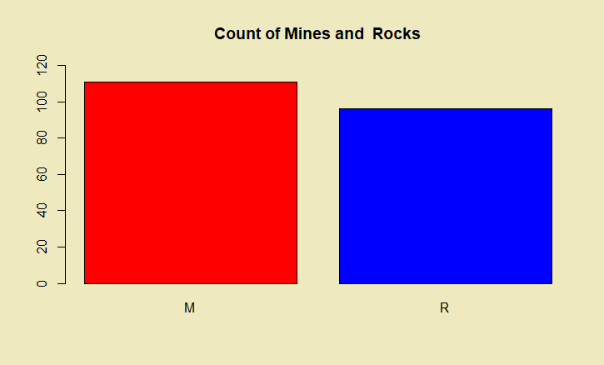
Explore the Data

Slide 11
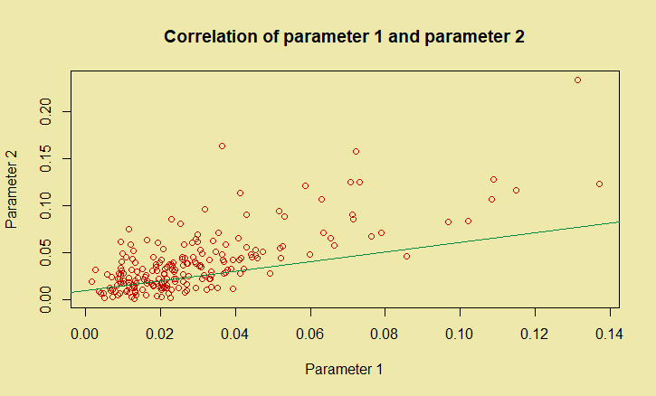
Explore the Data

Slide 12
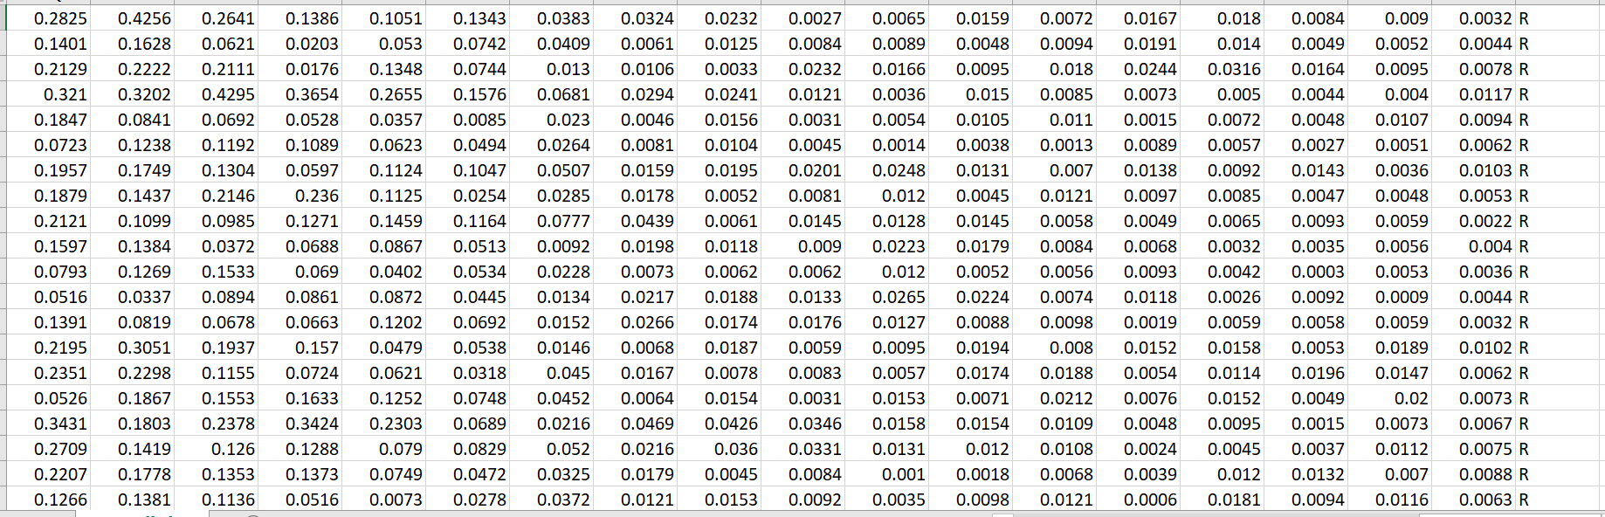
Explore the Data

Slide 13
Data Preparations
In this stage we organize the data performing transformations on the unorganized part of data.
The task is time consuming and tedious.
Steps in which the preparation is processed:
Clean the data
Construct the data
Integrate and form the data.

Slide 14
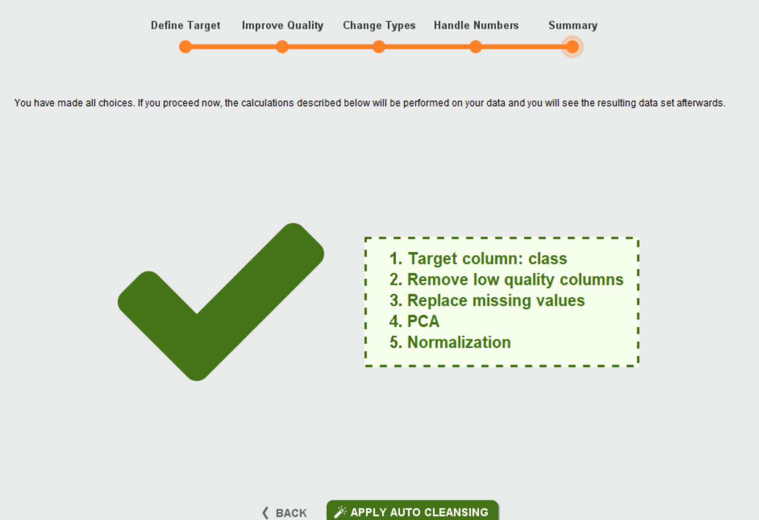
Data Cleansing
Scaling of the independent attributes.
Remove low quality columns.
There are no missing values.

Slide 15
Modelling
Since the data is cleaned and prepared we proceed to build the model.
We will be using AutoModel technique to understand the performance of each model.
We will be building the following 4 models:
Support Vector Machine(SVM)
Generalized Linear Model (GLM)
Naïve Bayes
Deep Learning
After AutoModel Support Vector Machine(SVM) is the best performing model.

Slide 16
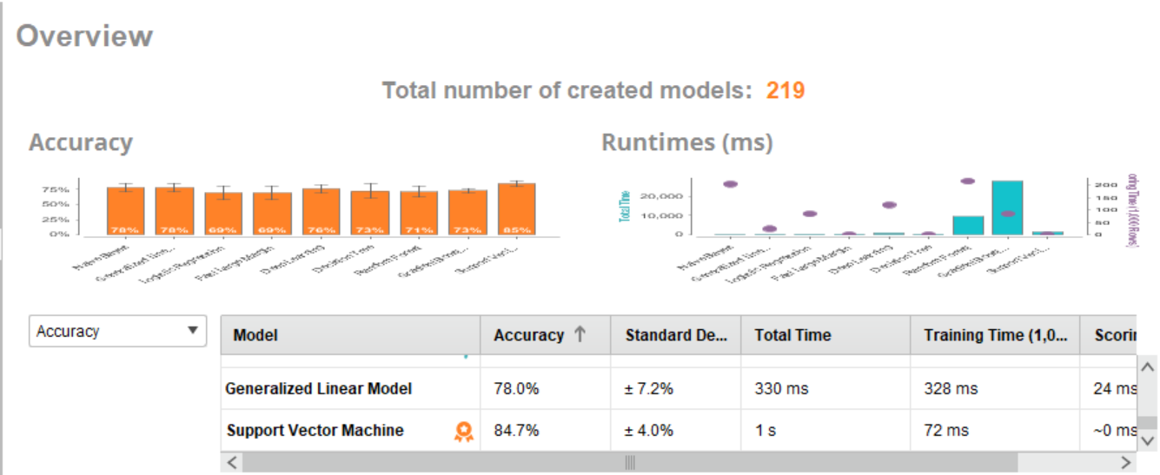
Modelling

Slide 17
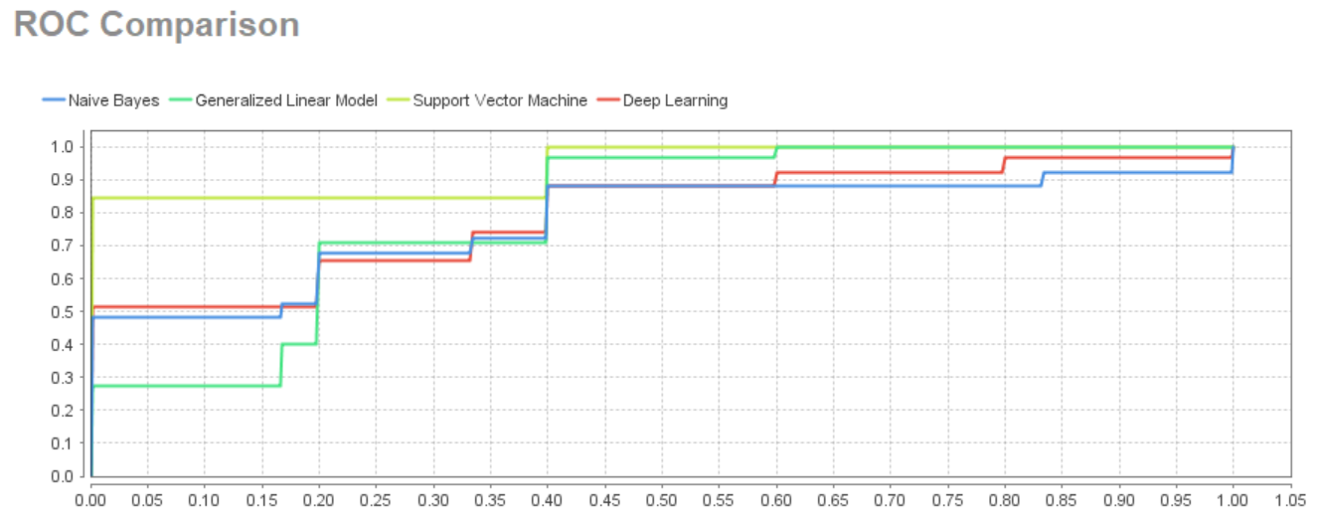
Modelling
Relative Operating Characteristics (ROC) curve is used to compare quality and performance of various models.

Slide 18
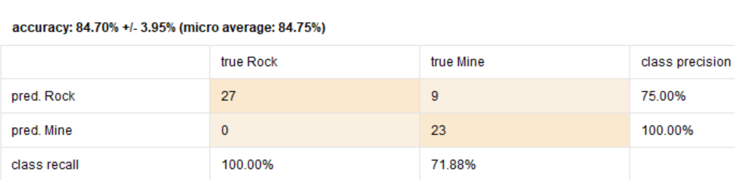
Evaluation
Support Vector Machine - Performance

Slide 19
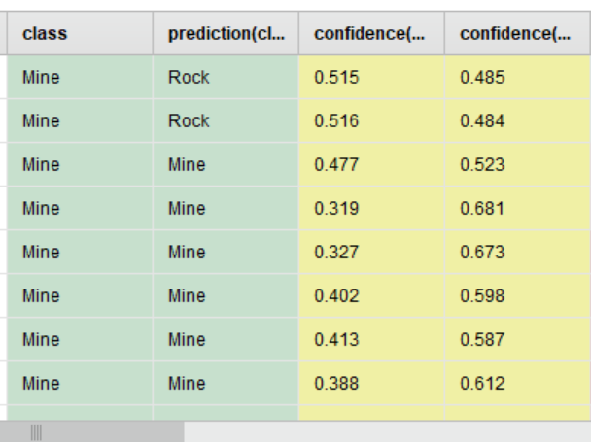
Evaluation
Support Vector Machine – Predicitons
The model is tested against real world use cases

Slide 20
Deployment
Based on the real world we have generated the prediction report of the model.
It gives a good understanding to the stakeholders of the objectives achieved.
The model needs to be maintained and monitored.
Check the accuracy of the model according to the plan in regular intervals with the new facts is mandatory.
We can change the model if any of the parameters are changed or added.

Slide 21
Conclusion
We have seen various stages of CRISP-DM.
We saw how the tasks are performed and accuracy of the models is implemented in CRISP-DM.
Thus we have successfully achieved the objectives using CRISP-DM Methodology.

